Slide 1

Angular js : UI-ROUTER
July 2015
Gauthier Peel

Slide 2
Split an application
Service area
Site = menu + service
Service area = real content
Switch from an activity to another
Use html target to define a state/service
#/todolist/create
Angular-ui-router = librairy managing the routing

Slide 3
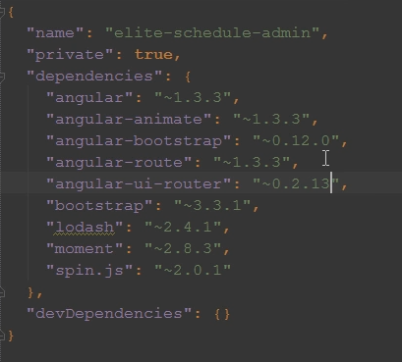
Router
Setup (1/2)
Add a bower dep :
Run >bower install

Slide 4
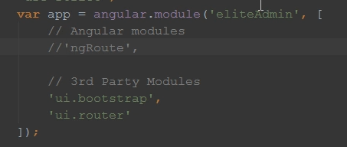
Router
Setup (2/2)
Add the reference to your index.html page
Add it to your angular module deps :

Slide 5
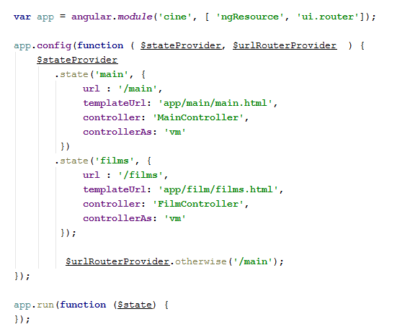
Configuration
Add <div ui-view> in your template file
Define routes
Better : without the '
controller : FilmController

Slide 6
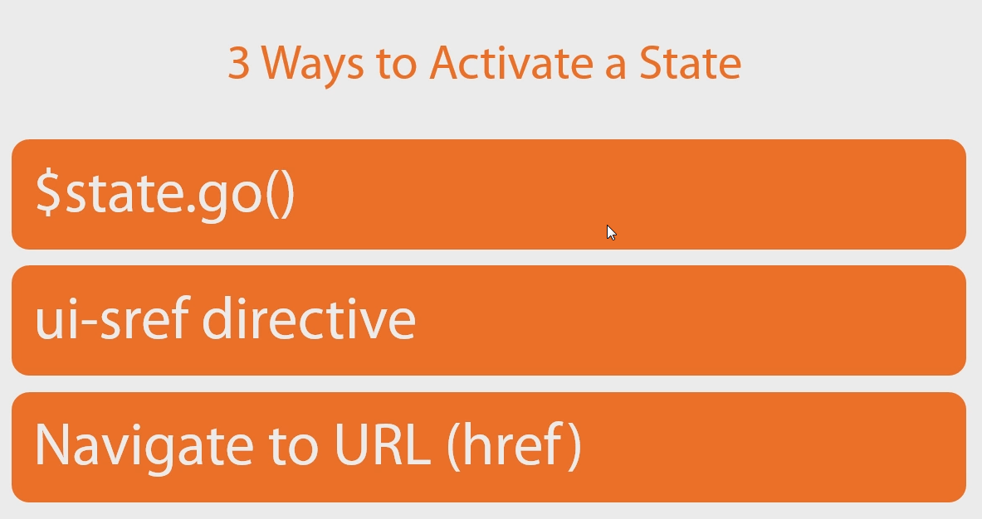
Router
Changing route

Slide 7



Router
Changing Routes
ui-sref could be used on <a>, <button> , on ANYthing !
$state.go
If you want to refresh data, use the reload param as :

Slide 8
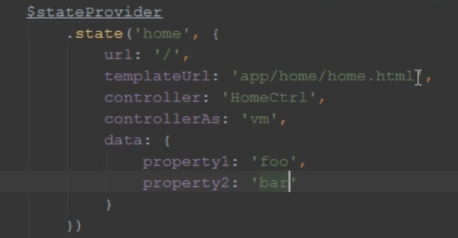
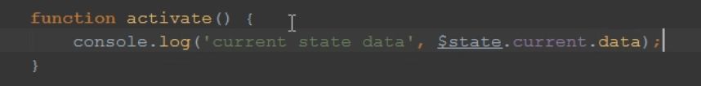

Router
Passing Data
the property name 'data' is required to define some param in the state

Slide 9
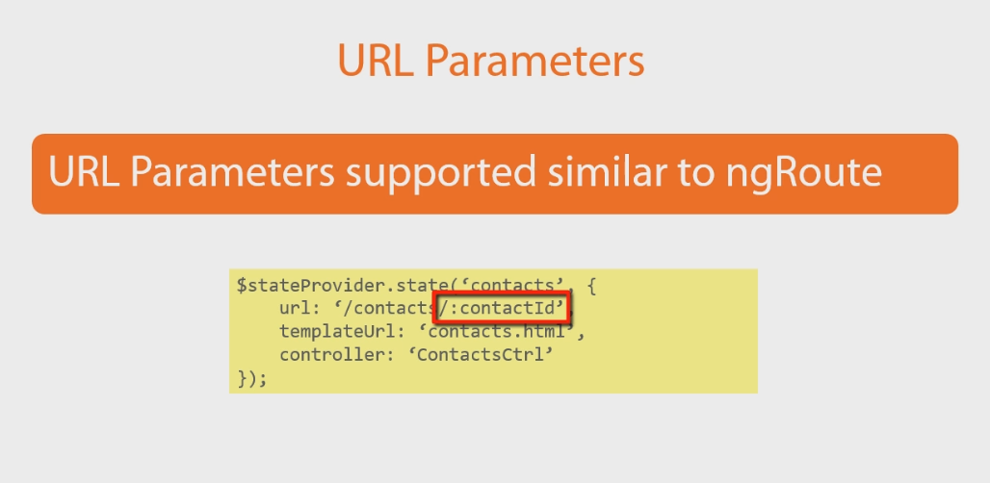
Router
Passing parameters

Slide 10
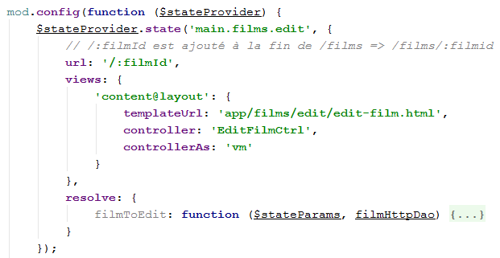

AngularJS

Slide 11
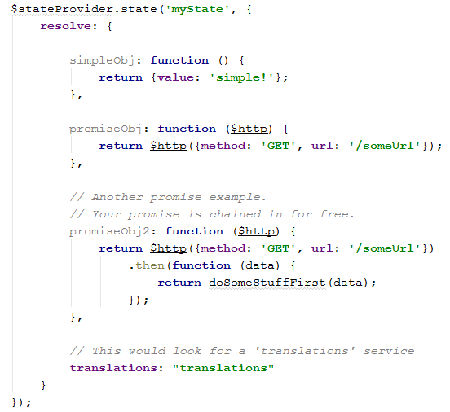
AngularJS
Using state param in URL resolve ....
Resolution gives a chance to prepare data and inject them in the controller when they are ready.

Slide 12

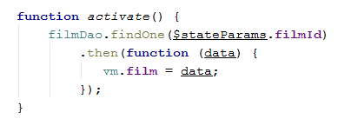
AngularJS
UI-Router syntax : JS Navigation to the state 'main.films.edit' with the URL param filmId
Starting the nav in JS :
On the FilmEditController : selection on the film to edit :

Slide 13
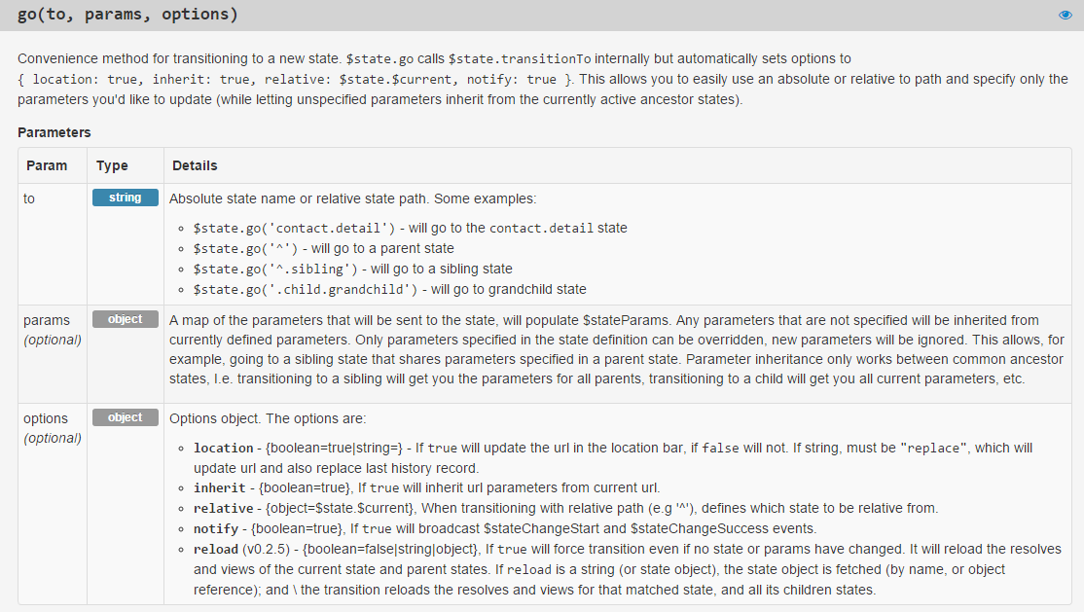
Router
$state.go
$state.go( state, {}, { reload : true});

Slide 14
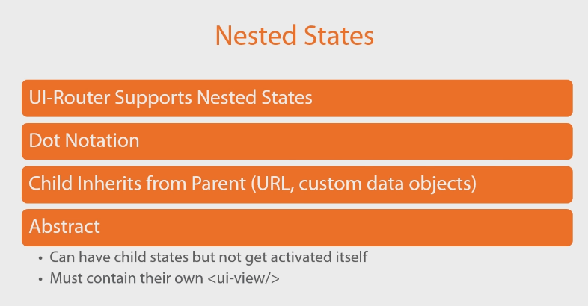
Router
Nested states

Slide 15
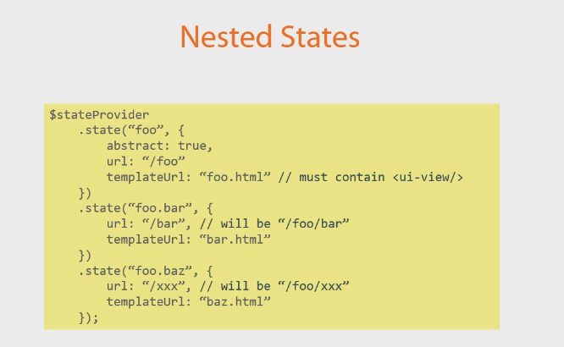
Router
Nested States

Slide 16
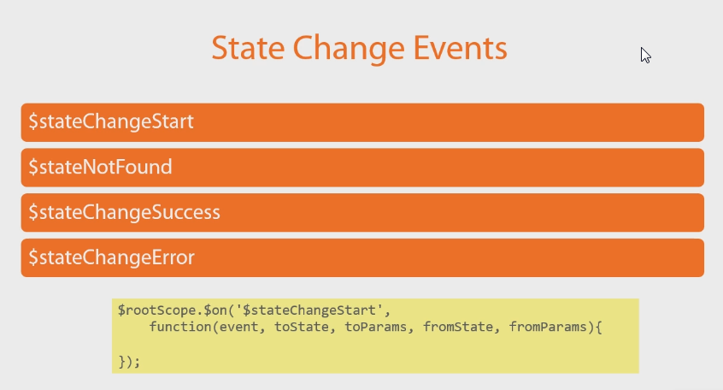
Router
Event

Slide 17
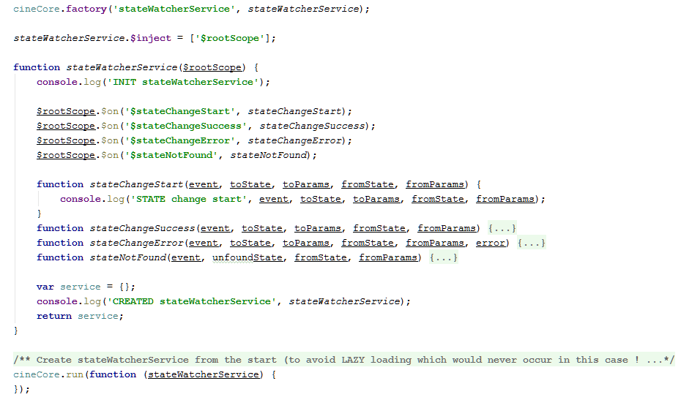
AngularJS
Debugging state change

Slide 18
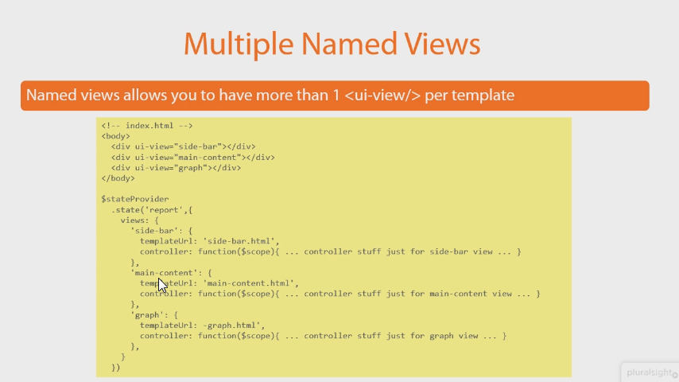
Router

Slide 19
AngularJS
PluralSight Angular UI Fundamental by Steve Michelotti
chapter 3 : UI-Router
http://www.pluralsight.com/courses/angularui-fundamentals

